Slide 1
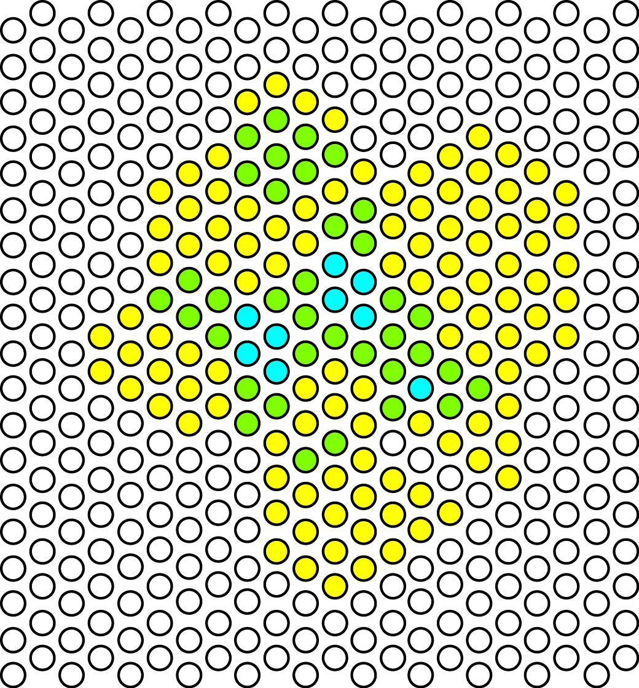

euler calculus
for data
robert ghrist
andrea mitchell university
professor of mathematics &
electrical/systems engineering
the university of pennsylvania
focm : budapest : july : 2011

Slide 2

motivation

Slide 3

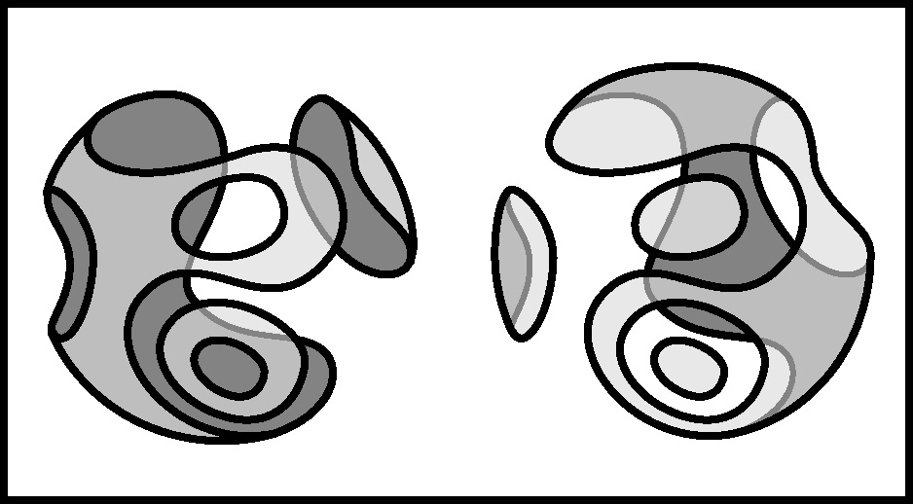
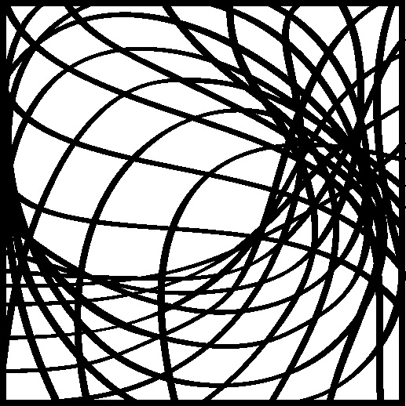
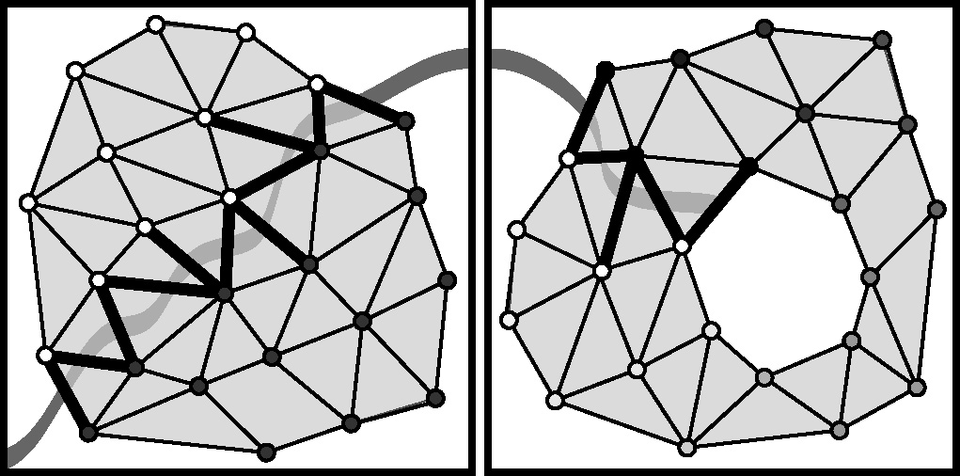
tools

Slide 4
euler calculus
geometry
blaschke
hadwiger
rota
chen
topology
∫ h dχ
kashiwara
macpherson
schapira
viro
probability
networks
adler
taylor

Slide 5
ingredient #1: χ
χ = Σ (-1)^{k} # {k-cells}
χ
= 7
_{k}
= Σ (-1)^{k} rank
_{k}
χ
= 3
H_{k}
H_{c}
_{k}
χ
= 2
χ(AuB) = χ(A)+ χ(B) – χ(A B)
u
χ
= 3

Slide 6

ingredient #2: CF(X)
fix category of “tame” or “definable” sets (semialgebraic, subanalytic, …)
CF(X) = Z-valued functions whose level sets are locally finite
and definable
all definable sets are triangulable & have
a well-defined euler characteristic
results
all functions in CF(X) are of the form
h = Σc_{i}1_{Ui} for U_{i} definable

Slide 7
integration: explicit
explicit definition:
euler integral
∫ h dχ
= ∫ (Σ c_{i}1_{Ui}) dχ
= Σ(c_{i} ∫1_{Ui})dχ
= Σc_{i} χ(U_{i})
the integral is independent of how the integrand is decomposed…
…thanks to mayer-vietoris
χ(AuB) = χ(A)+ χ(B) – χ(A B)
u

Slide 8
integration: implicit
[schapira; via kashiwara, macpherson, 1970’s]
the right-derived direct image on CF is the
correct way to understand dχ
F
X
Y
CF(X)
CF(Y)
F*
in the case where Y is a point, CF(Y)=Z, and the pushforward is a homomorphism from CF(X) to Z which respects all the gluings implicit in sheaves...
X
pt
CF(X)
CF(pt)=Z
∫ dχ
F
X
Y
pt
corollary: [schapira, viro; 1980’s]
fubini theorem
CF(X)
CF(Y)
CF(pt)=Z
F*
∫ dχ

Slide 9
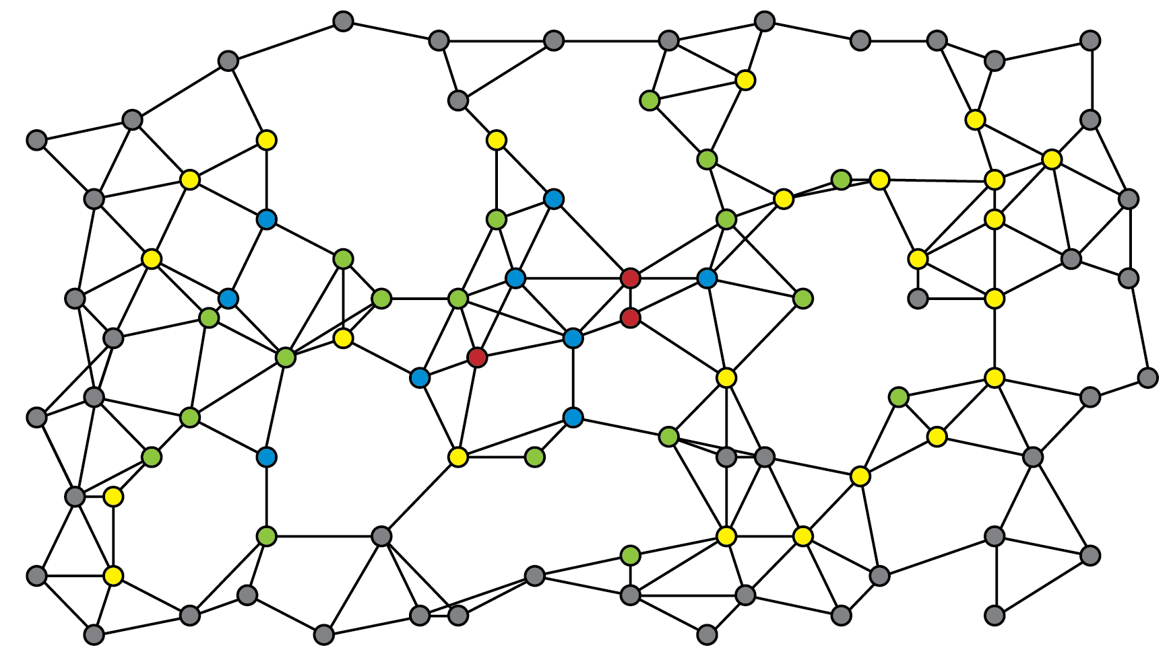
problem
a network of “anonymous” sensors returns target counts without IDs
= 0
= 1
= 2
= 3
= 4

Slide 10
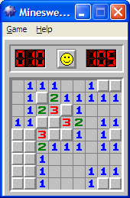
problem

Slide 11
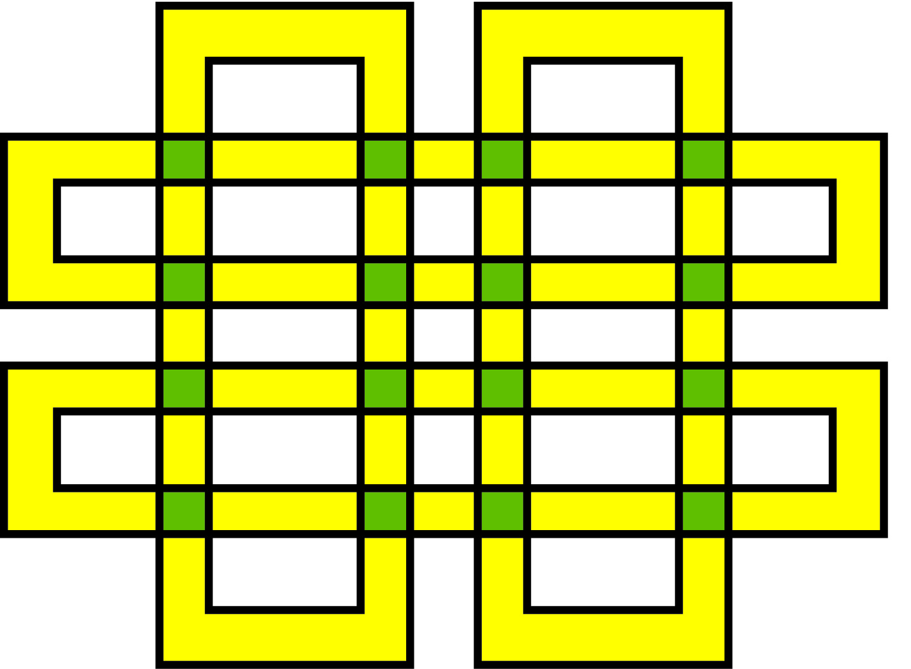
enumeration
let W = “target space”
= space where finite # of targets live
let X = “sensor space”
= space which parameterizes sensors
target i is detected on a target support U_{i} in X
h:X→Z
sensor field on X returns h(x) = #{ i : x lies in U_{i} }
2
theorem: [BG] assuming target supports with uniform χ(U_{i})=N
# targets = (1/N) ∫_{X} h dχ
N ≠ 0
∫ h dχ
= ∫ (Σ1_{Ui}) dχ
= Σ(∫ 1_{Ui} dχ)
= Σ χ(U_{i})
= N # i

Slide 12
computation
integrals with respect to dχ are computable via
∫ h dχ
∞
= Σ s χ({ h=s })
_{s=0}
level set
∞
= Σ χ({ h>s })-χ({ h<-s })
upper excursion set
_{s=0}

Slide 13
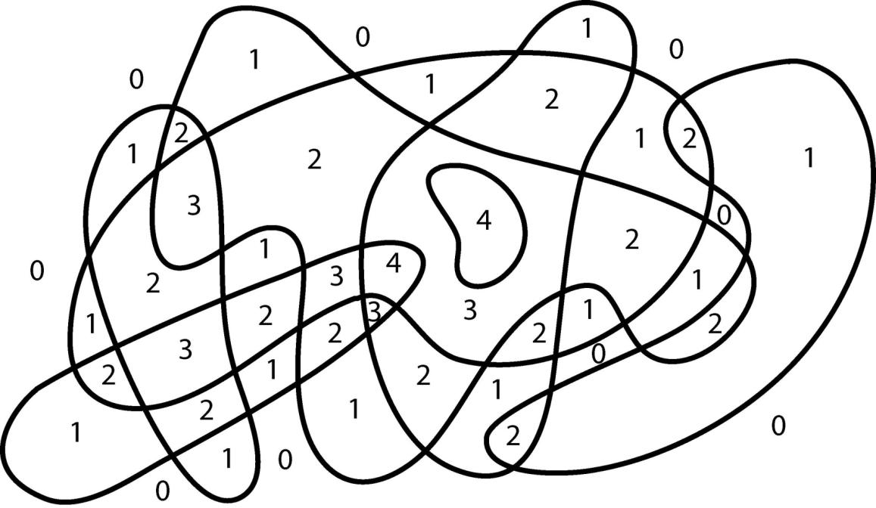
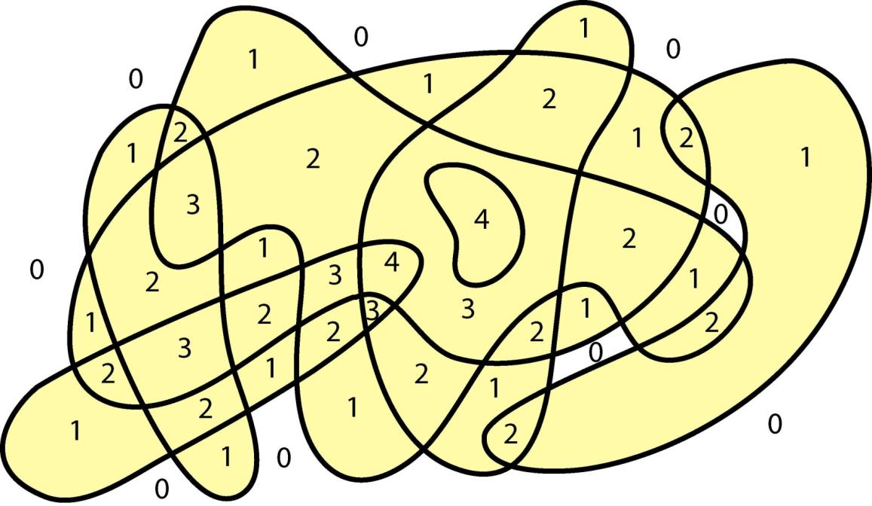
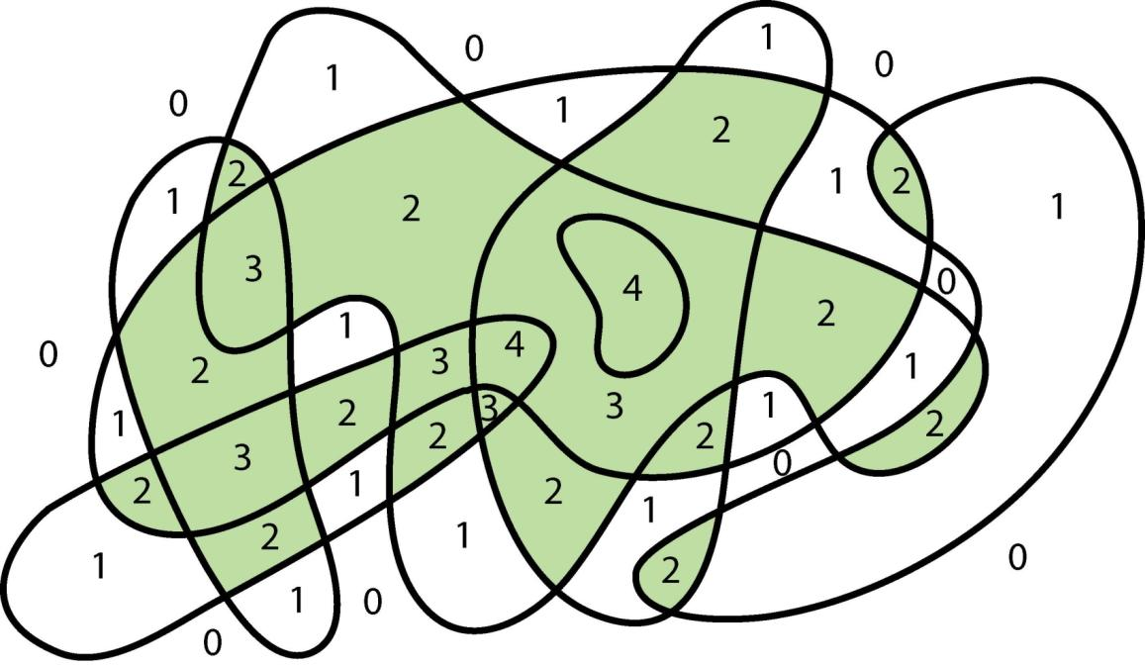
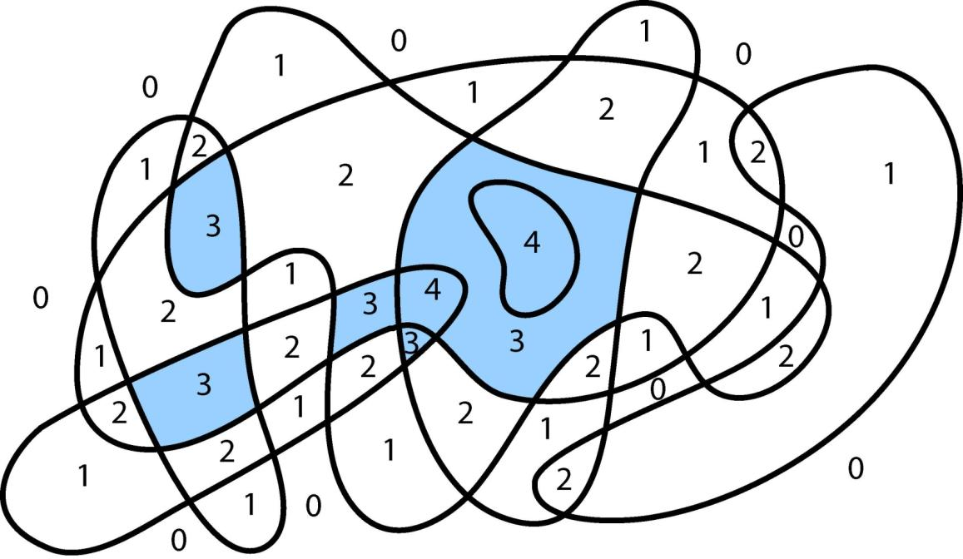
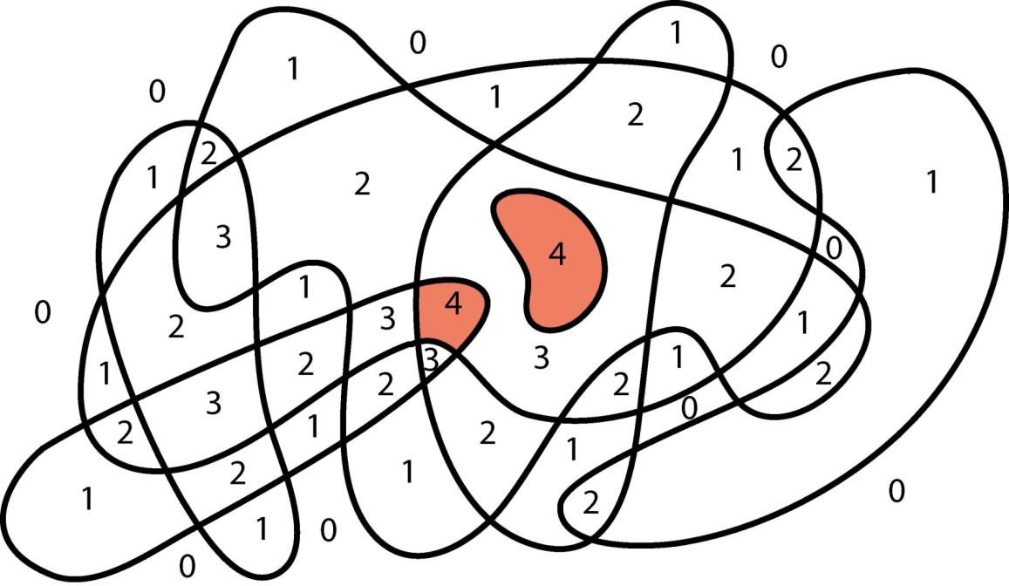
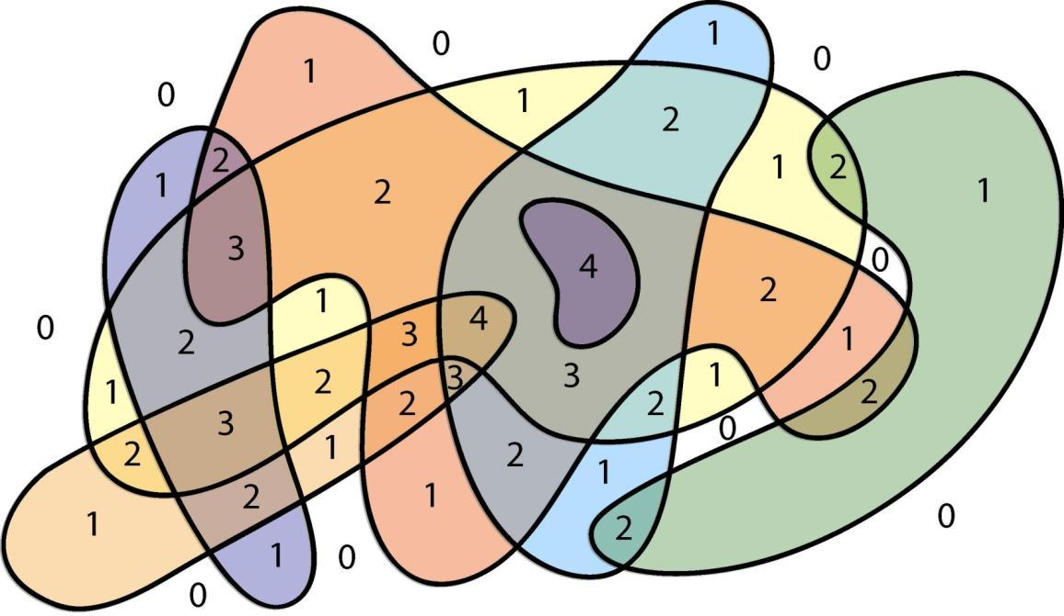
example
∫ h dχ
= Σ χ {h(x)>s}
∞
_{s=0}
h>3 : χ = 2
h>2 : χ = 3
h>1 : χ = 3
h>0 : χ = -1
net integral = 2+3+3-1 = 7

Slide 14
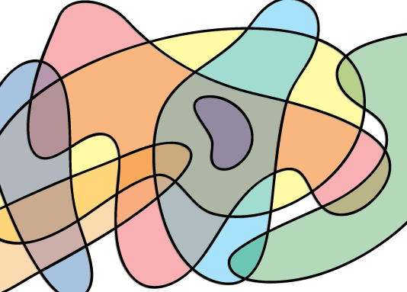
numerical integration

Slide 15
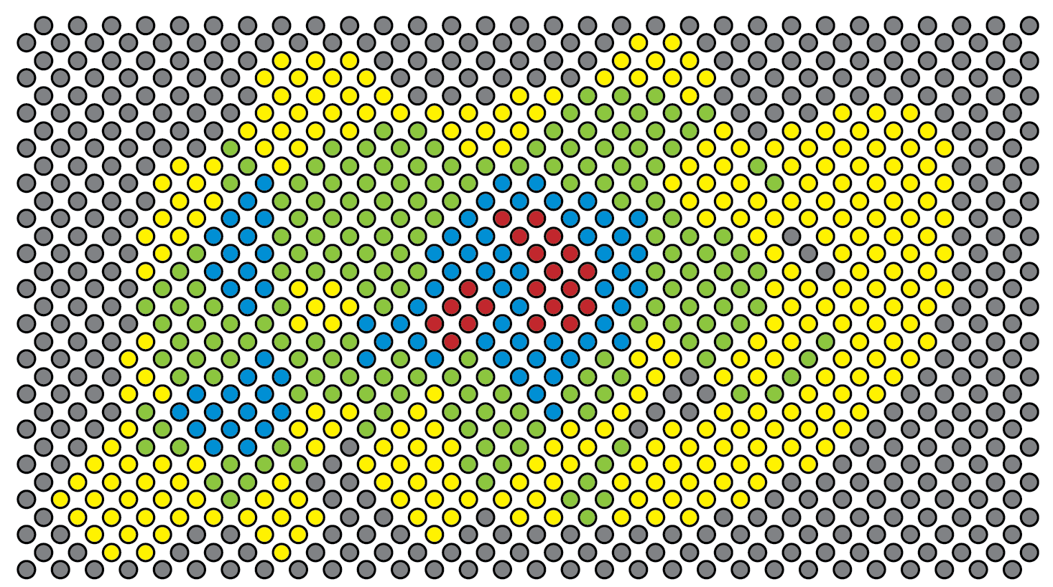
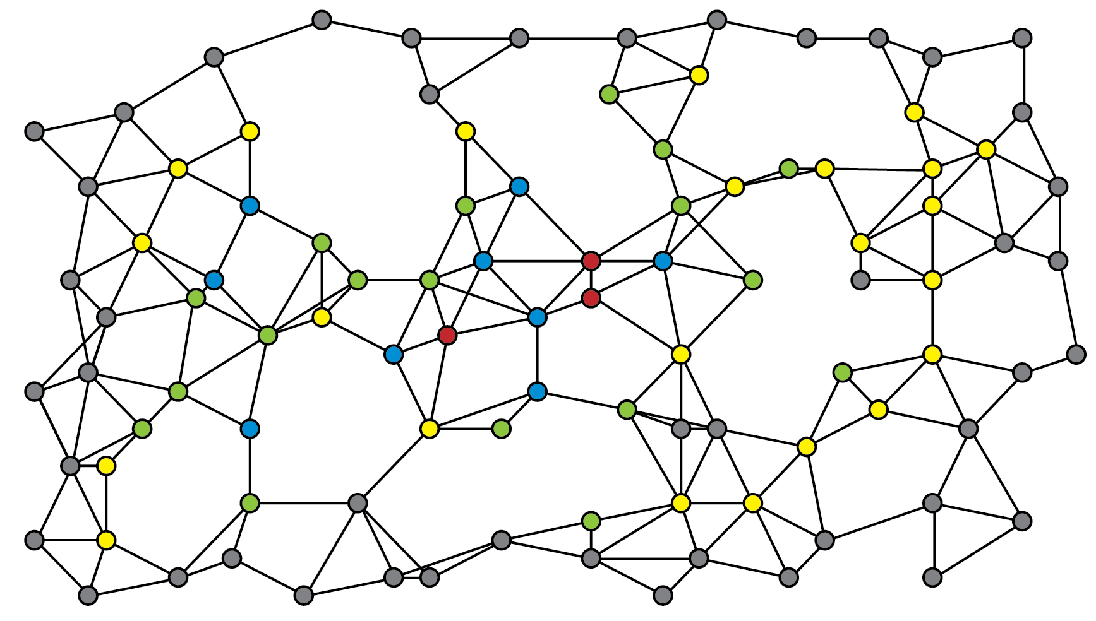

Slide 16
w / yuliy baryshnikov
ad hoc networks
theorem: [BG] if the upper semicontinuous function h:R²→N is sampled over a network in a way that correctly samples the connectivity of upper and lower excursion sets, then the exact value of the euler integral is
∞
Σ( #comp{ h≥s } - #comp{ h<s } + 1)
_{s=1}
this is a simple application of alexander duality…
∞
∫ h dχ
= Σ χ{h ≥ s}
∞
= Σ b₀ {h ≥ s} – b₁{h ≥ s}
_{s=1}
_{s=1}
∞
= Σ b₀{h ≥ s} – b⁰{h < s}
~
_{s=1}
∞
= Σ b₀{h ≥ s} – b₀{h < s} + 1
_{s=1}
this works in ad hoc setting : clustering gives fast computation

Slide 17
w / yuliy baryshnikov
exploiting numerical error
prop: [BG] if a sum of characteristic functions of convex annuli in general position in the plane is sampled over a sufficiently dense lattice, then
#annuli = ½ ∫ _{theother} ∫_{oneway} h dχ dχ
this takes advantage of the errors implicit in numerical integration & fubini

Slide 18
integral transforms

Slide 19
radon transform
the topological radon transform R_{S} : CF(W) ←→ CF(X)
X
S
W
∫_{X} h dχ = N ∫_{W} 1_{T} dχ = N #T
h = integral transform of 1_{T}
theorem: [schapira] if fibers of S are regular, then R_{S} is self-invertible
R_{S}(R_{S} h) = (μ – λ)h + λ1_{W} ∫ h dχ

Slide 20
microlocal fourier transform
the microlocal fourier(-sato) transform MF : CF(R^{n}) → CF(R^{n})
MF(h)(x,ξ) = lim ∫ 1_{ξ●(x-y)≥0} h(y) dχ(y)
ξ
_{B(ε,x)}
x
_{ε → 0}⁺
theorem: [cf. brocker-kuppe] averaging the MF over ξ yields
∫_{S}^{n-1} ∫ MF(h)(x,ξ) dχ(x) dξ = vol(S^{n-1}) ∫ h dχ
corollary: for X definable in R^{n} the ξ - average of MF(1_{X}) is
[gauss-bonnet]
1
χ(X) = ∫_{S}^{n-1} ∫ MF(1_{X})(x,ξ) dχ(x) dξ
vol(S^{n-1})
∫_{X} dκ

Slide 21
toward numerical analysis…

Slide 22
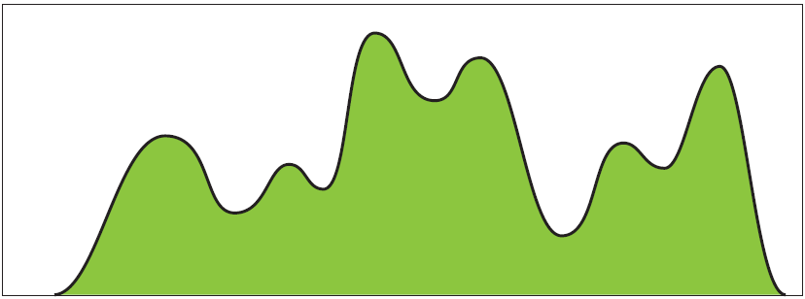
w / yuliy baryshnikov
real-valued integrands
it’s helpful to have a well-defined integration theory for R-valued integrands:
Def(X) = R-valued functions whose graphs are “tame” (definable)
a riemann-sum definition
∫ h ⎣dχ⎦ = lim 1/n∫ ⎣nh⎦ dχ
≠
∫ h ⎡dχ⎤ = lim 1/n∫ ⎡nh⎤ dχ

Slide 23
w / yuliy baryshnikov
real-valued integrands
lemma
if h is affine on an open simplex σ, then
h
∫ h ⎣dχ⎦ = χ(σ) inf h
∫ h ⎡dχ⎤ = χ(σ) sup h
∫ x ⎣dχ⎦ + ∫ 1-x ⎣dχ⎦
=
0 + 0
∫ ⎣dχ⎦ nonlinear
(0,1)
(0,1)
∫ 1 ⎣dχ⎦
fubini fails
= –1
(0,1)
however…
there is a strong connection to morse theory…

Slide 24
w / yuliy baryshnikov
morse interpretation
intuition: the two measures correspond to the stratified morse indices
of the graph of h:X→R with respect to two graph axis directions…
Ind↑ , Ind↓ : Def(X)→CF(X)
Ind↑(h)(x) = lim χ(B_{ε}(x) ∩ {h<h(x) + ε’})
_{ε’<< ε → 0}⁺
Ind↓(h)(x) = lim χ(B_{ε}(x) ∩ {h>h(x) – ε’})
_{ε’<< ε → 0}⁺
theorem: [BG] for h in Def(X) ∩ C(X)
∫ h ⎣dχ⎦ = ∫ h Ind↑(h) dχ
∫ h ⎡dχ⎤ = ∫ h Ind↓(h) dχ

Slide 25
w / yuliy baryshnikov
morse interpretation
intuition: the two measures correspond to the stratified morse indices
of h or -h
LMDI : Def(X)→CF(X)
LMDI(h)(x) = lim χ(B_{ε}(x) ∩ {h>h(x) – ε’})
_{ε’<< ε → 0}⁺
theorem: [BG] for h in Def(X) ∩ C(X)
∫ h ⎣dχ⎦ = ∫ h LMDI(-h) dχ
∫ h ⎡dχ⎤ = ∫ h LMDI(h) dχ

Slide 26
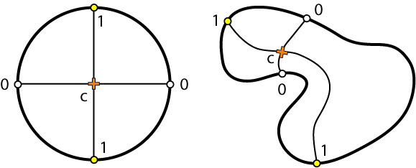
w / yuliy baryshnikov
morse interpretation
corollary: [BG] if h : X → R is morse on an n-manifold, then
∫ h⎣dχ⎦
= Σ h(p) (-1)^{n-μ(p)}
∫ h⎡dχ⎤
= Σ h(p) (-1)^{μ(p)}
_{crit(h)}
_{crit(h)}
corollary: [BG] if h is univariate, then ∫ h ⎣dχ⎦ = totvar(h)/2 = –∫ h ⎡dχ⎤
∫ h ⎣dχ⎦ = 1+1-c

Slide 27
integral transforms

Slide 28
euler-fourier transform

Slide 29
euler-bessel transform

Slide 30
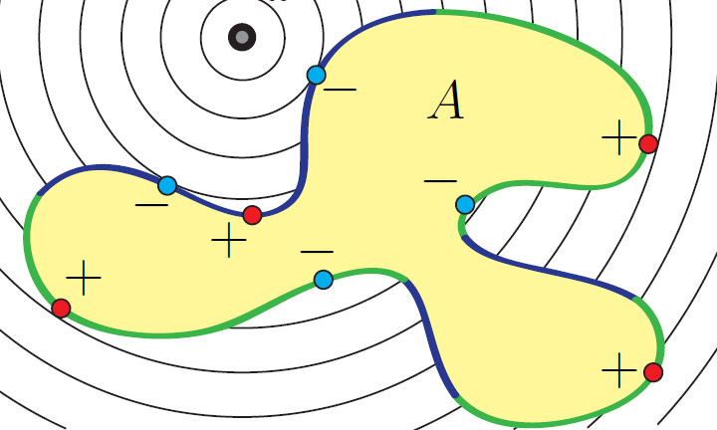
w / michael robinson
euler-bessel transform
the euler-bessel transform B: CF(R^{n}) → Def(R^{n})
∞
Bh(x) = ∫ ∫_{d(x,y)=s} h(y) dχ ds
0
theorem: [GR] for A codimension-0 submanifold (w/corners)
B1_{A}(x)=∫_{∂A+} d_{x} ⎣dχ⎦ - ∫_{∂A-} d_{x} ⎡dχ⎤
cor: in even dimensions,
B1_{A}(x)=∫_{∂A} d_{x} ⎣dχ⎦
this yields an index theory
for computing B

Slide 31
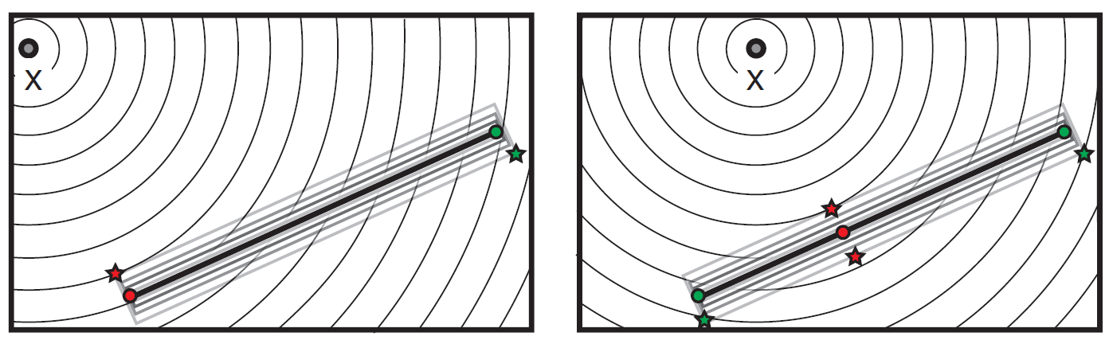
w / michael robinson
euler-bessel transform
the euler-bessel transform B: CF(R^{n}) → Def(R^{n})
∞
∞
Bh(x) = ∫ ∫_{d(x,y)=s} h(y) dχ ds
= ∫ ∫ h(y) ds ⎣dχ ⎦
0
0
this yields index-theoretic formulae for fast computation of the transform

Slide 32
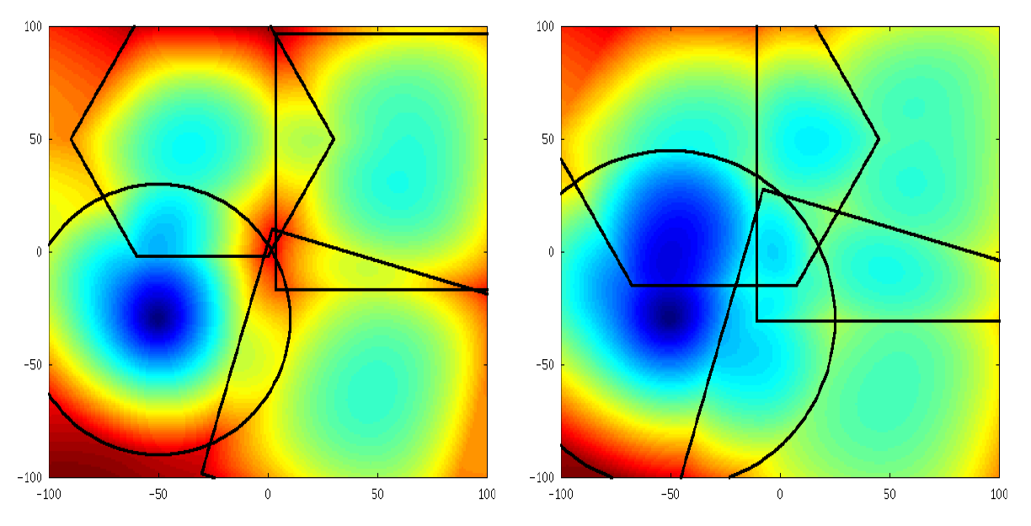
w / michael robinson
shape discrimination
an L₂ bessel transform detects circular targets from anonymous counts

Slide 33
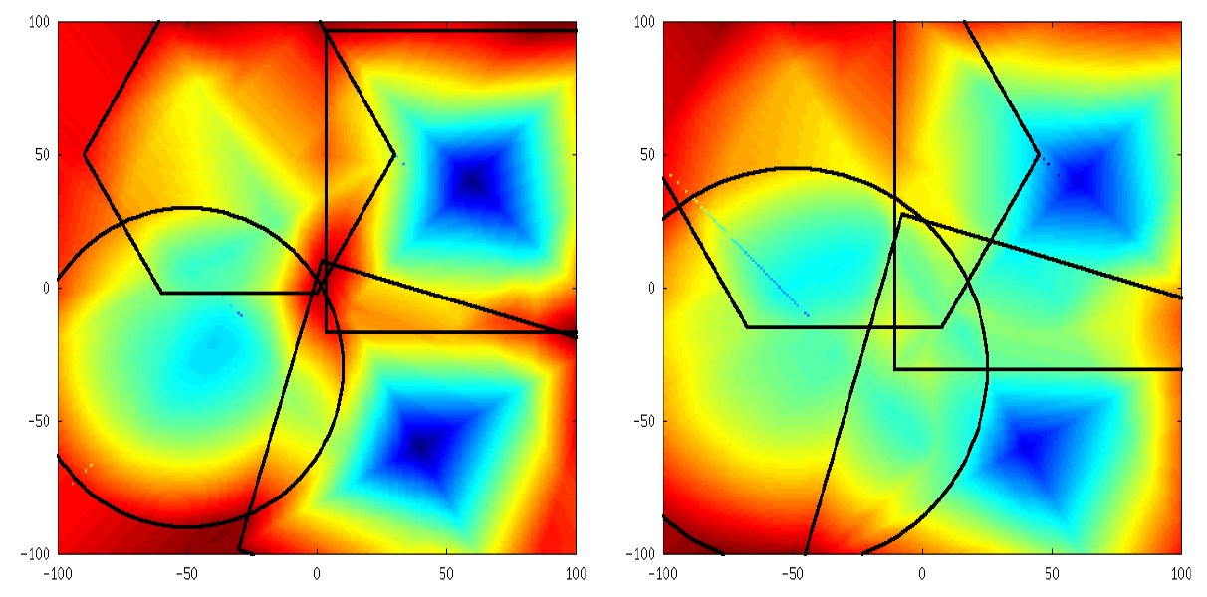
w / michael robinson
shape discrimination
an L∞ bessel transform + SVA detects square targets up to rotation

Slide 34
concluding
postscript…

Slide 35
constructible sheaves
w / yasu hiraoka
network coding sheaves
for a network flow sheaf S on X with cut A, H¹(X,A;S) is the obstruction to max-cut/min-flow
0 → H⁰(X,A;S) → H⁰(X;S) → H⁰(A;S) → H¹(X,A;S) → H¹(X;S) →
network switching sheaves
w / michael robinson
data
output
enable
sheaf cohomology → global information flows

Slide 36
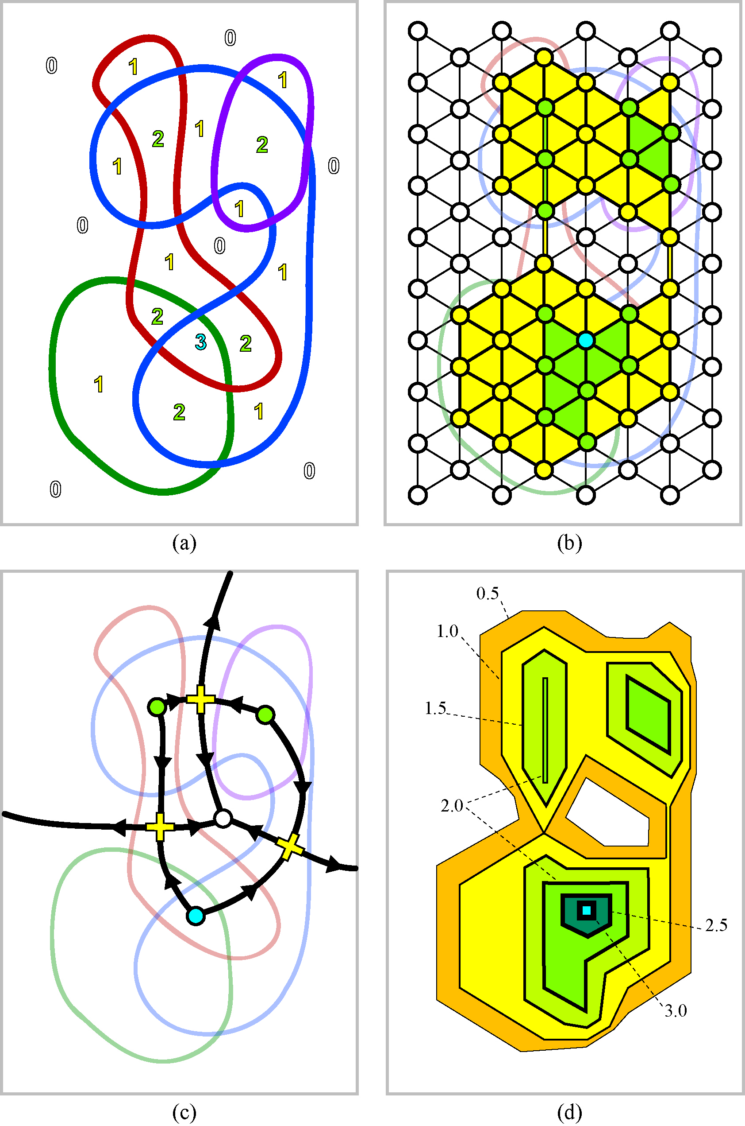
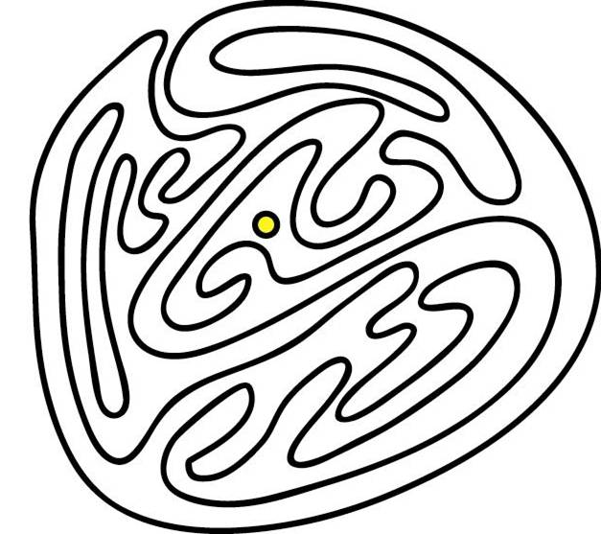
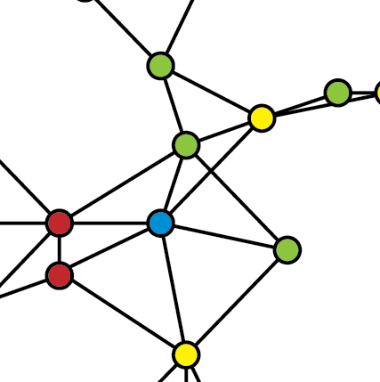
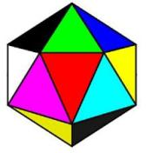
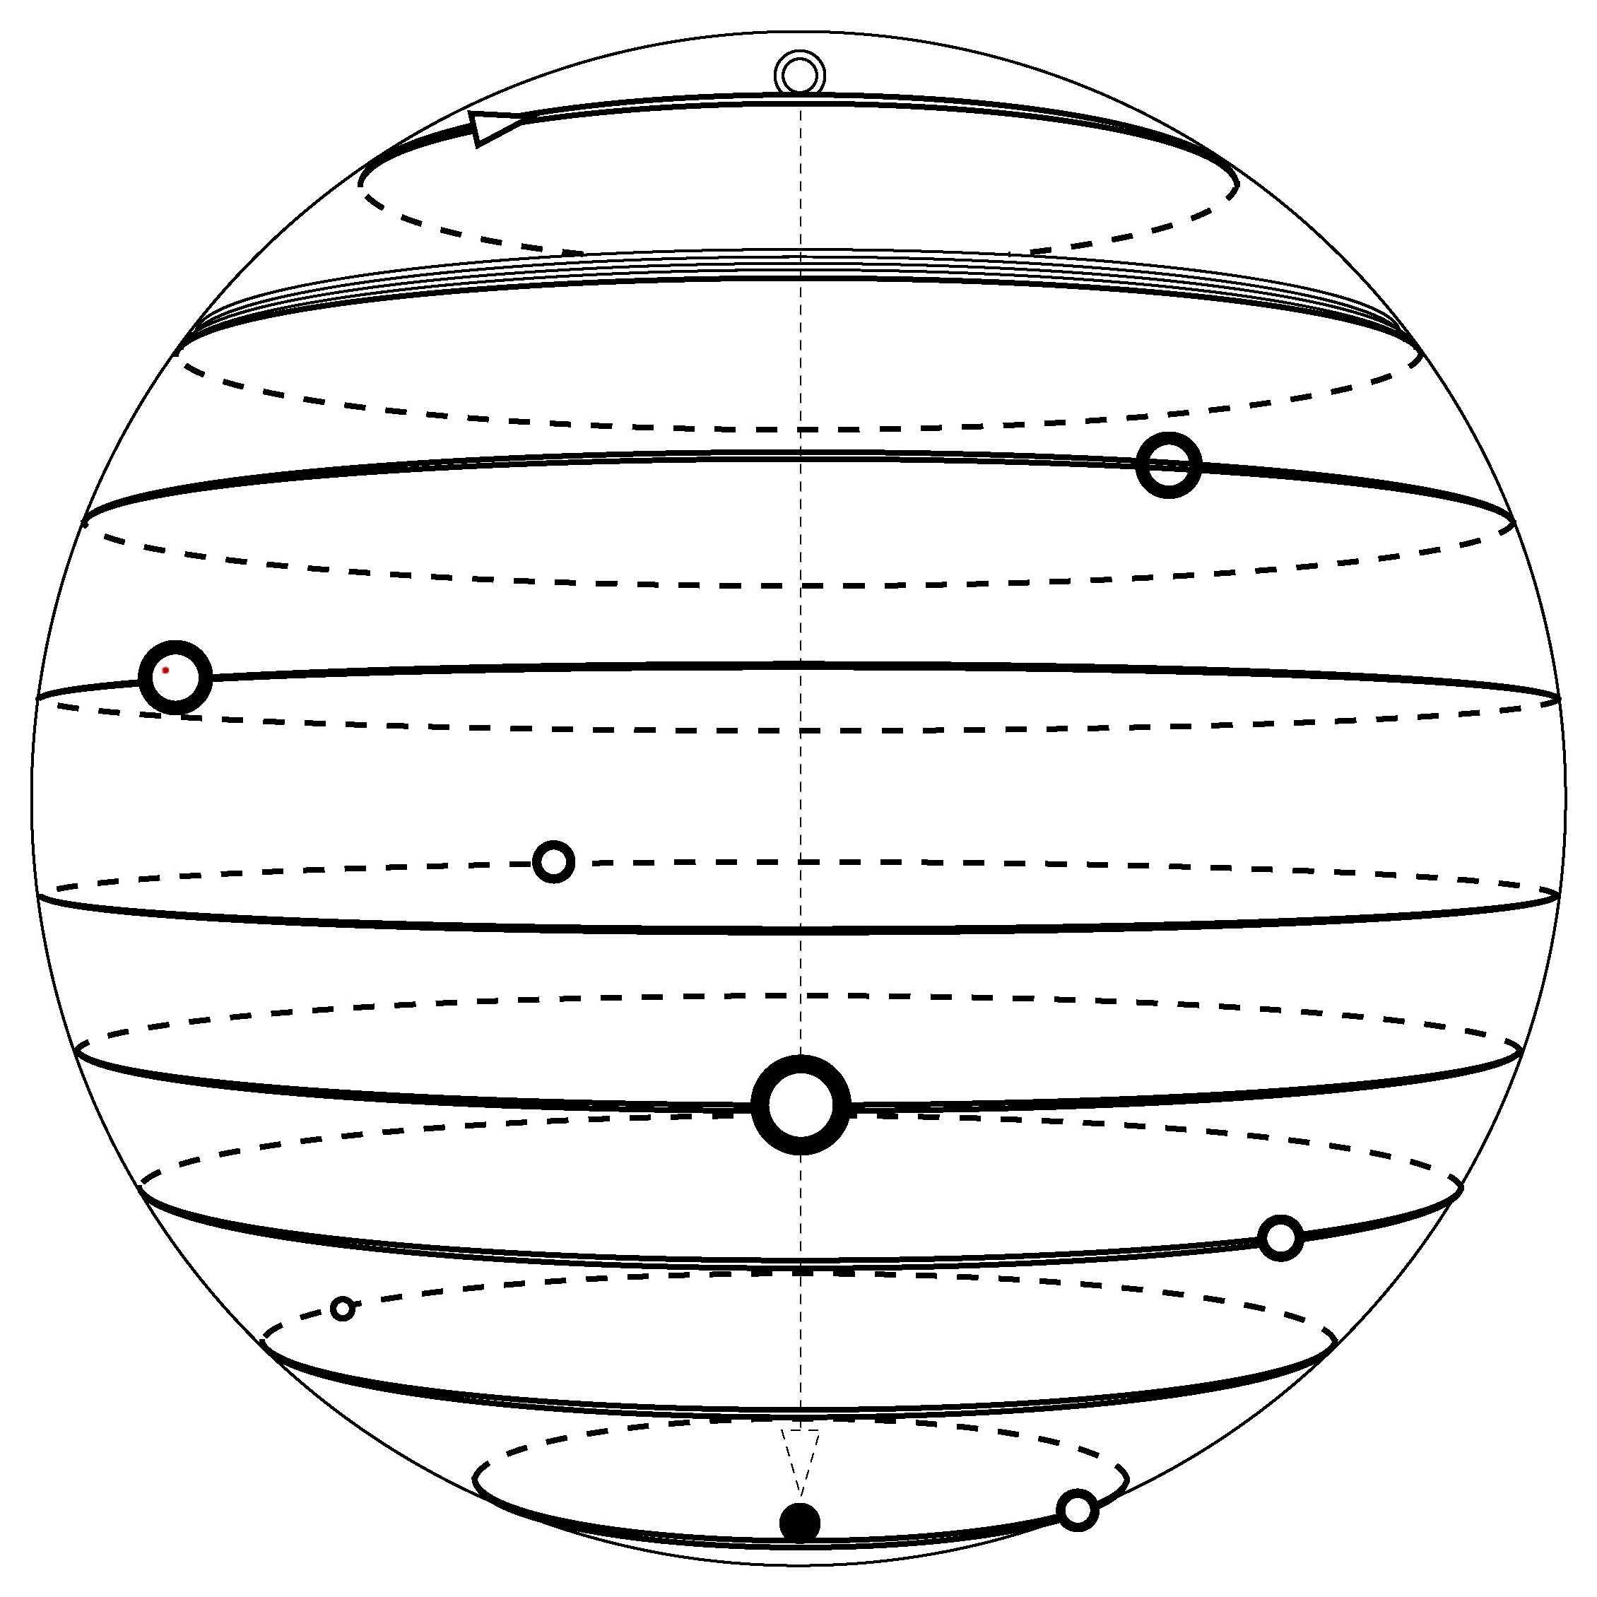
applied topology

Slide 37
closing credits…
research sponsored by
darpa (stomp program)
air force office of scientific research
office of naval research
primary collaborators
yuliy baryshnikov, univ. illinois
michael robinson, penn
david lipsky, penn
professional support
university of pennsylvania
andrea mitchell
java code
david lipsky, penn
naveen kasthuri, penn
a.j. friend, stanford

